Slide 1
Hidden.ny
By saif nachmi

Slide 2
Plan
What is hidden.ny?
Does our web is responsive ?
How we created the slideshow?
How we created a form?

Slide 3
WHAT IS HIDDEN.NY?
Hidden.ny is a online shoes store where u can do ur shopping from ur house.
Hidden.ny is a beta version thats why we got only home page and contact page.
Our page is made up with html,css and js

Slide 4
Does our web is responsive ?
Ofc our web is responsive, we used bootstraps and other web sites like w3scools which means there already responsive.

Slide 5
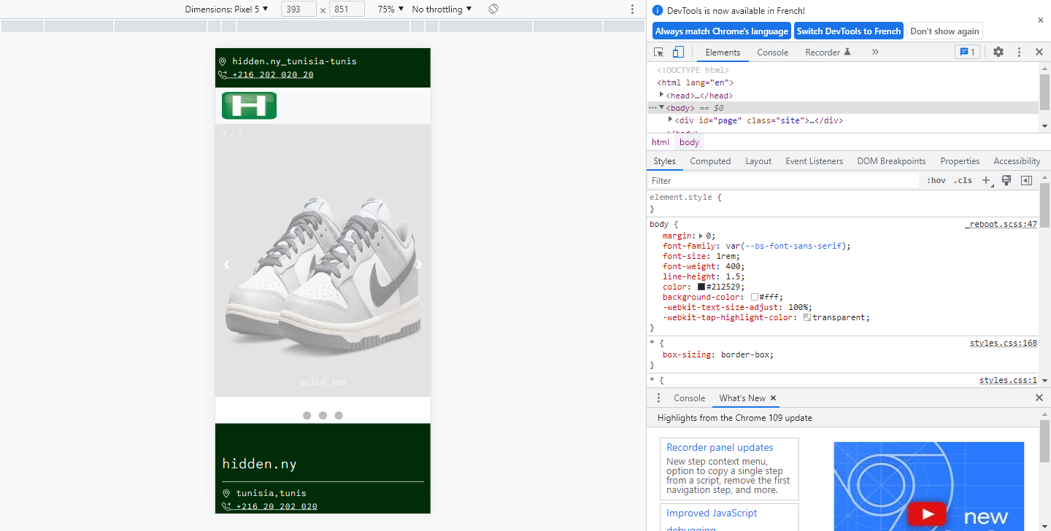

Slide 6
How we created the slideshow?
It was kinda hard to do a slideshow at first but then i had to do a research.
In the next slide u'll find how i did it step by step

Slide 7
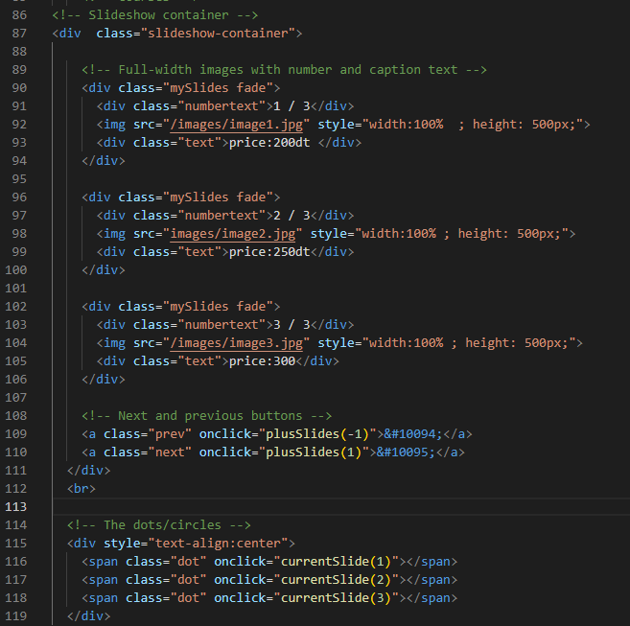
Html:

Slide 8
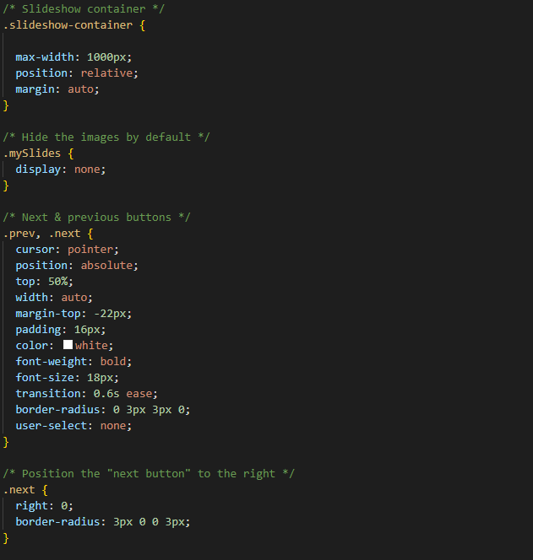
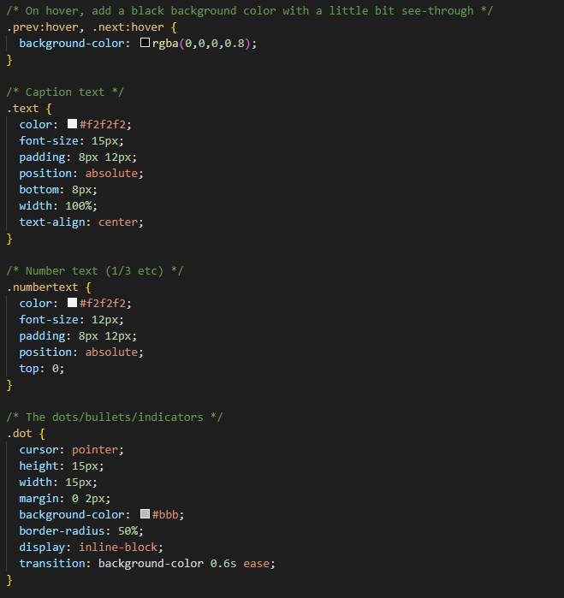

Slide 9
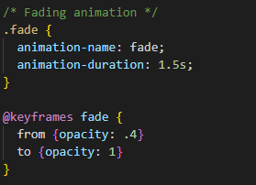

Slide 10
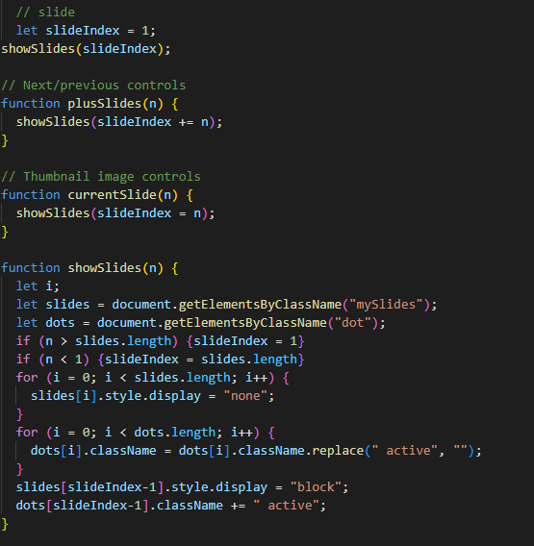
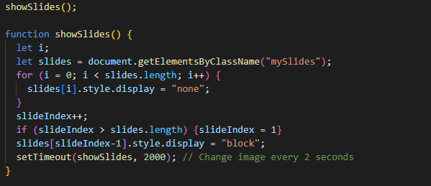

Slide 11
How we created a form?
To create this form, i used another html page and then i used some help in csss to make it look more better and responsive.
In the next slide u'll find the js.

Slide 12
